Slide 1

Notes:
Bad postures in an interview

Slide 2
Notes:
Correct sitting postures for Men and Women

Slide 3
Presentation Skills
Chapter: 15

Slide 4
Success at speaking can come to all speakers, whatever their talent, if they follow the 3 Ps:
Step 1: Prepare carefully.
Step 2: Practice often.
Step 3: Perform with enthusiasm.

Slide 5
Structuring your content
Sample structure
Title page
An attention‐grabber
Outline
Introduction / background
Body / main part
Summary / conclusion
Focus on the central message
Avoid jargons
Conclude powerfully with a take home message

Slide 6
Classification
Format | From informal question/answer sessions to formal speeches
Number of Presenters | From several-minute overviews to long sessions of an hour or more
Content | From a few highlights to detailed coverage

Slide 7
Common Presentation Situations
Getting Hired
Getting Customers
Keeping Customers
Contributing to your Profession
Contributing to your community
Getting promoted

Slide 8
Make your Body language work for you
Use of Space
Can Everyone See You?
Movement
Good posture
Use of hand gestures
Smile
Nervous? Just Slow Down
Speak slowly
Make yourself understood by others

Slide 9
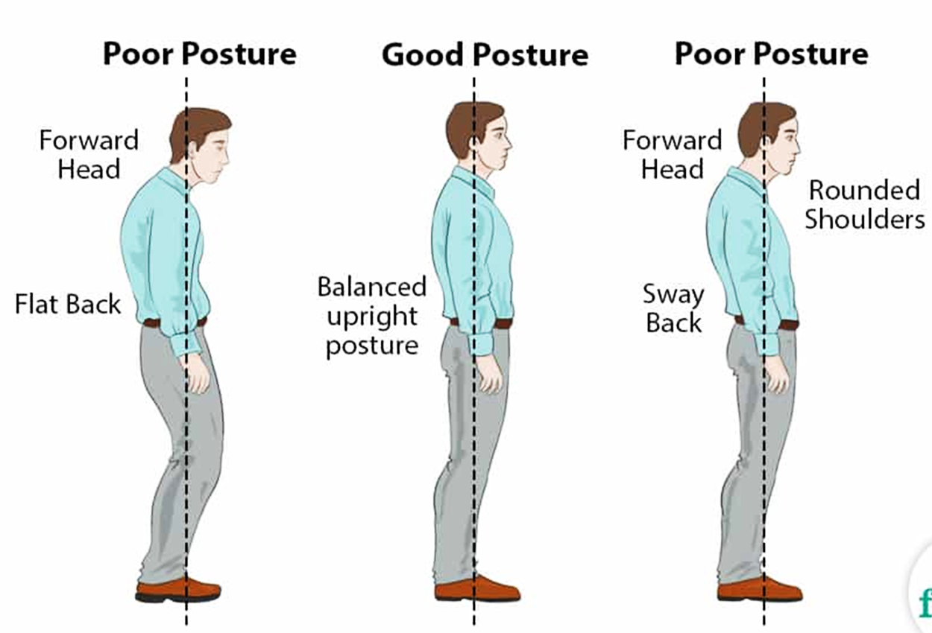

Slide 10
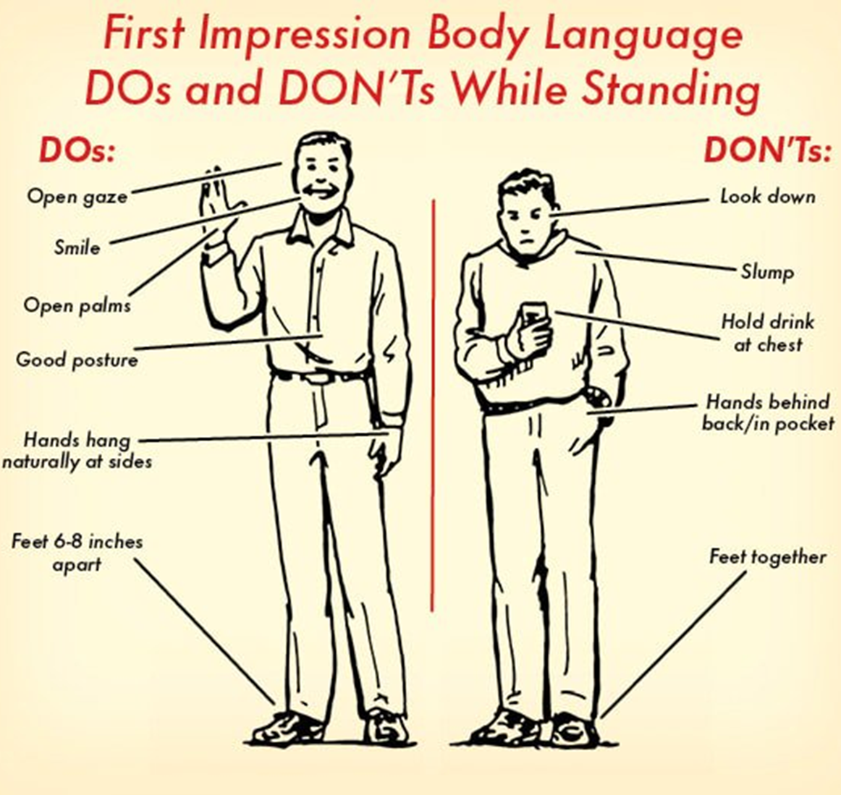

Slide 11
Feel Confident from Inside
Don't think too much about what people will think
Don't keep practicing till the last moment for a meeting or presentation
Talk to people there

Slide 12
Formal Dressing for Men
For dress shirts, prefer plain and decent colours like light tones of blue and beige
Wear black or dark coloured trousers matching with the socks
The tie should be darker than the shirt and match with the suit.
Do not pick ties with loud colours and patterns
The belt should also match with the shoes.
Also the metal of the buckle of a belt, tie bar and the cufflinks must coordinate.
Cufflinks, tie bar and wrist watch add a more formal look to the dressing.

Slide 13




Slide 14
Formal Dressing for Women
Choose small design prints or plain suits with decent and soft colour shades.
Avoid sharp bright colours.
Do not wear heavy jewelry.
Avoid pencil heels. Wear coat shoes or sandals.
Wear skin coloured socks if needed.

Slide 15
Presentation Guidelines

Slide 16
Presentation Guidelines
Know Your Listeners
Use the Preacher’s Maxim: First you tell ’em what you’re gonna tell ’em, then you tell ’em, and then you tell ’em what you told ’em.
Stick to a Few Main Points
Put Your Outline on Cards or Paper
Practice, Practice, Practice
Speak Vigorously and Deliberately
Maintain Eye Contact

Slide 17
Notes:
Audience sections

Slide 18
Presentation Guidelines
Use Appropriate Gestures and Posture
Avoid Filler Words (uhhhhh … ya know …OK … well … uh … like … I mean … umm …)
Use Rhetorical Questions

Slide 19
Sample Presentation Structure
Introduction: “Last year, Jones Engineering had 56 percent more field accidents than the year before. This morning, I’ll examine a proposed safety plan that aims to solve this problem. My presentation will focus on three main benefits of the new plan: lower insurance premiums, less lost time from accidents, and better morale among the employees.”
Body: “The final benefit of the new safety plan will be improved morale among the field workers at all our job sites.”
Conclusion: “Jones Engineering can benefit from this new safety plan in three main ways.…If Jones implements the new plan next month, I believe you will see a dramatic reduction in on-site accidents during the second half of the year.”

Slide 20
The Do’s and the Don’ts
Allow plenty of time to prepare your talk
Practice!
Know your audience
Use appropriate graphics
Clarity, clarity, clarity
Keep your time
Be personable in taking questions
Enjoy and learn from your mistakes
Don’t put in too much material
Don’t waste time at the start
Don’t block the slides during the talk
Avoid making distracting sounds
Engage your audience

Slide 21
Audio-visual Aids

Slide 22
Presentation Graphics Guidelines
Discover listener preferences
Match the graphics to the content
Consider alternatives to bulleted lists
Use colors carefully
Learn the tools available to you
Leave graphics up long enough
Use handouts when necessary
Maintain eye contact while using graphics
Plan for technology to fail
Notes:
“Visuals have the greatest, longest lasting impact – show as much or more visually as what you say”

Slide 23
Text Guidelines
Use Text Sparingly
No more than 5 bullet points per slide
Use READABLE fonts
Use colour for emphasis
Use contrasting background and text
Check for spelling and grammatical errors
Never use all capitals; harder to read

Slide 24
Media
Use appropriate media elements
Use readable graphs/tables
Avoid using pictures/ sounds that distract
Beware of copyrighted materials – mention sources
Don’t SAY it SHOW it

Slide 25
Handling Questions
Paraphrase questions
1. so that other people hear the question
2. to check you understand the questions
If you don’t know the answer, say so.
Offer to find out.
Ask the audience.

Slide 26
Conflict Resolution
If you are confronted with a challenge
Put it off until later
Let the situation diffuse
Give yourself some time to think about it
Give the person time to cool off
A listener who disagrees - try these responses:
That is an interesting perspective
Thanks for your input
Let me think about that some more and get back to you
I have several more ideas to share. We could talk about that point later, during a break

Slide 27
Overcoming Nervousness
Know your speech
Prepare yourself physically
Picture yourself giving a great presentation
Arrange the room as you want it
Have a glass of water nearby
Engage in casual banter before the speech
Remember that you are the expert
Do not admit nervousness to the audience
Slow down
Join a speaking organization

Slide 28
Common Pitfalls in Oral Presentations

